Slide 1
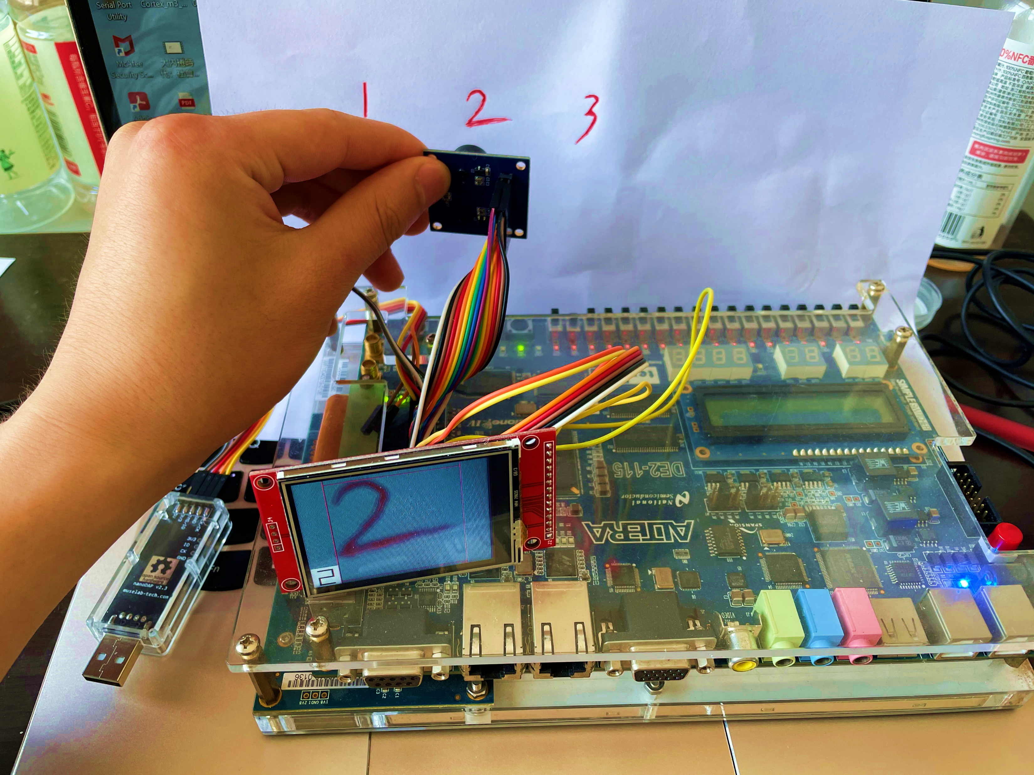
基于FPGA的手写体数字识别系统
17电子02郭世平

Slide 2
System Architecture
Cortex-M3 Integration
ACC
S0
S1
S2
S3
L1 AHB Bus Matrix
M0
M1
M2
M3
0x00000000
-0x0000ffff
AHB to Sram
0x20000000
-0x2000ffff
AHB to Sram
0x40000000
-0x4fffffff
AHB to APB
0x50000000
-0x5fffffff
AHB Bridge
ITCM
DTCM
0x10000
-0x1ffff
UART
0x20000
-0x2ffff
VGA
0x00000
-0x00fff
GPIO
0x01000
-0x0ffff
LCD
0x0010000
-0xdffffff
SDRAM
0xe000000
-0xe00ffff
Camera
apb subsystem
DMA

Slide 3
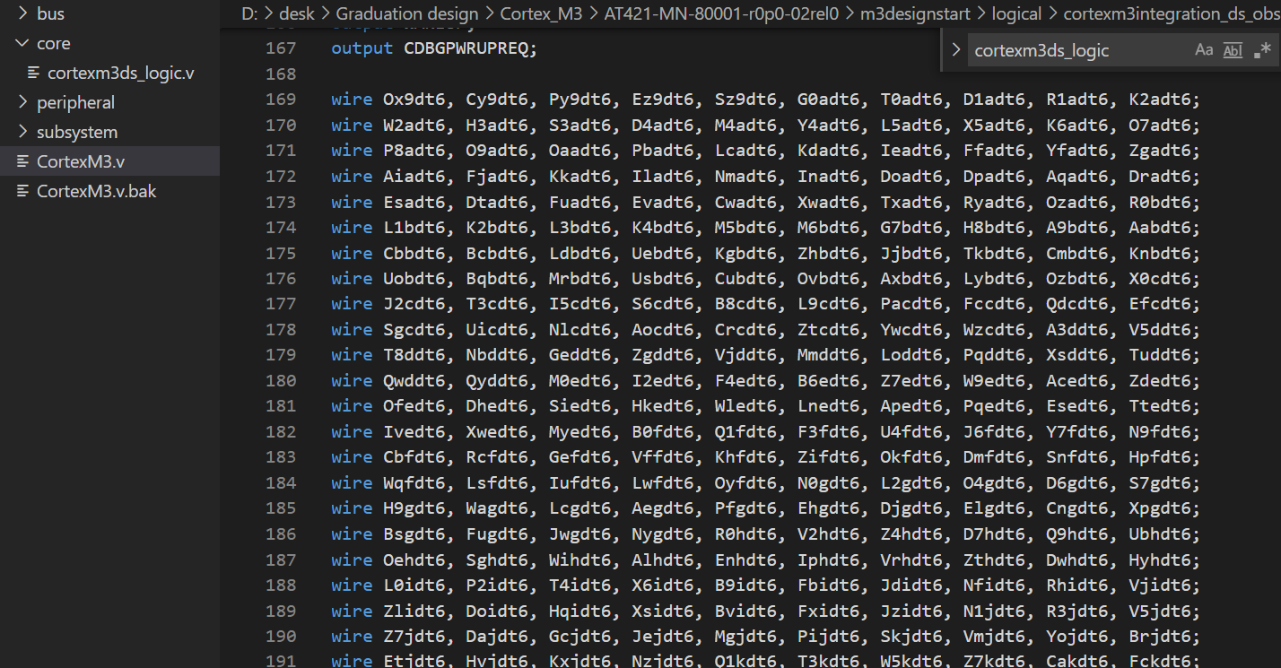
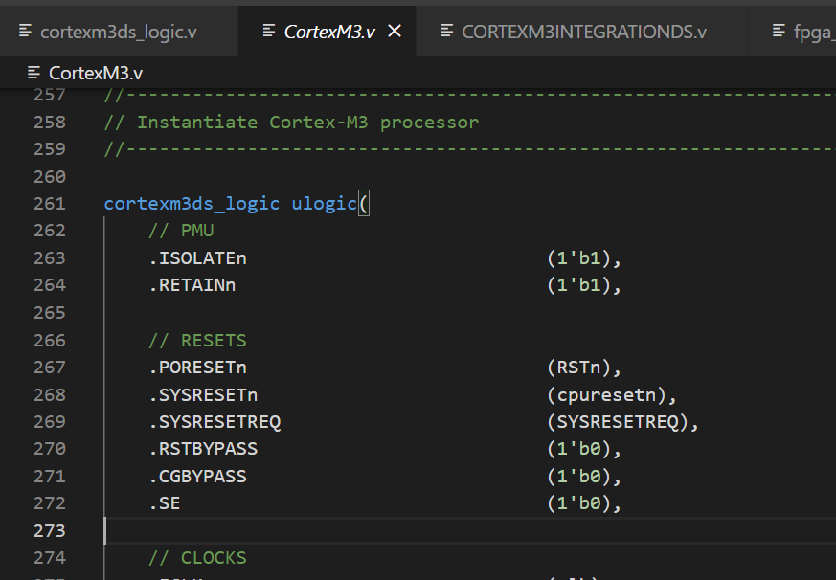
Cortex M3 microcontroller
Cortex-M3 Integration
ACC
S0
S1
S2
S3
L1 AHB Bus Matrix
M0
M1
M2
M3
0x00000000
-0x0000ffff
AHB to Sram
0x20000000
-0x2000ffff
AHB to Sram
0x40000000
-0x4fffffff
AHB to APB
0x50000000
-0x5fffffff
AHB Bridge
ITCM
DTCM
0x10000
-0x1ffff
UART
0x20000
-0x2ffff
VGA
0x00000
-0x00fff
GPIO
0x01000
-0x0ffff
LCD
0x0010000
-0xdffffff
SDRAM
0xe000000
-0xe00ffff
Camera
apb subsystem
DMA

Slide 4
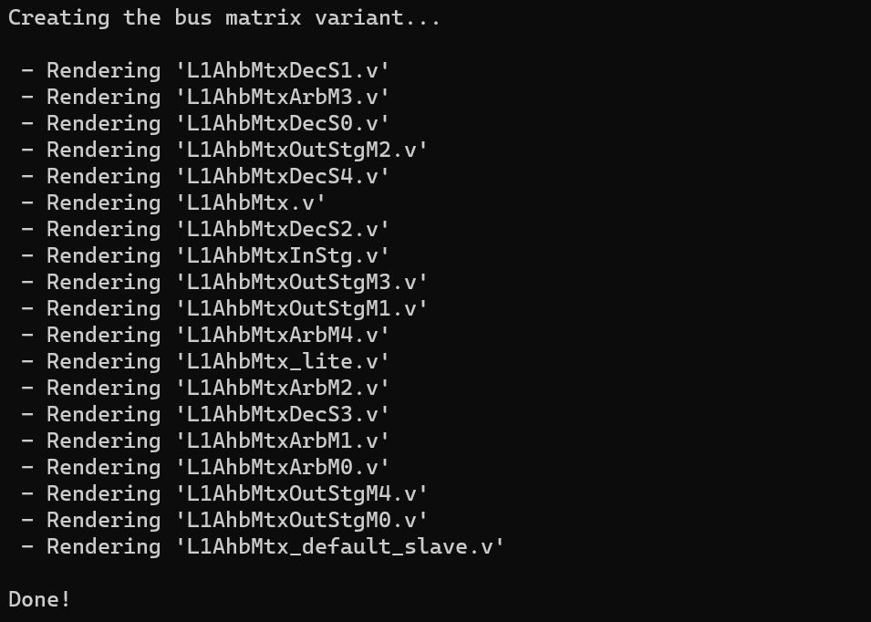
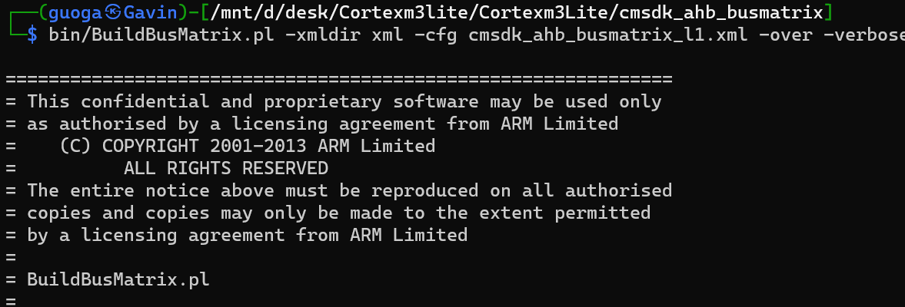
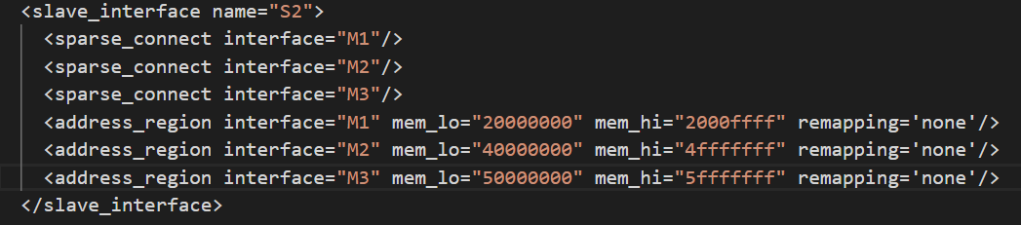
AHB Bus Generation
ACC
S0
S1
S2
S3
L 1 A H B B u s M a t r I x
Cortex-M3 Integration
M0
M1
M2
M3
0x00000000
-0x0000ffff
AHB to Sram
0x20000000
-0x2000ffff
AHB to Sram
0x40000000
-0x4fffffff
AHB to APB
0x50000000
-0x5fffffff
AHB Bridge
CMSDK(Cortex-M System Design Kit )
ITCM
DTCM
0x00000
-0x0ffff
GPIO
0x10000
-0x1ffff
UART
0x20000
-0x2ffff
VGA
0x00000
-0x0ffff
LCD
0x0010000
-0xdffffff
SDRAM
0xe000000
-0xe00ffff
Camera
apb subsystem
DMA

Slide 5
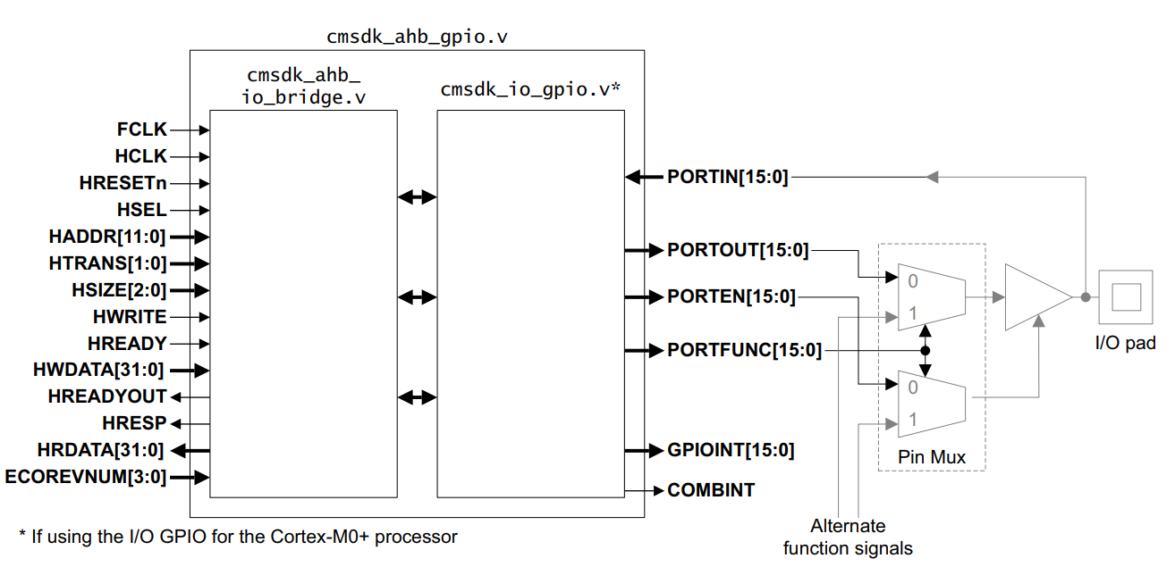
Basic System
Cortex-M3 Integration
ACC
S0
S1
S2
S3
L1 AHB Bus Matrix
M0
M1
M2
M3
0x00000000
-0x0000ffff
AHB to Sram
0x20000000
-0x2000ffff
AHB to Sram
0x40000000
-0x4fffffff
AHB to APB
0x50000000
-0x5fffffff
AHB Bridge
ITCM
DTCM
0x10000
-0x1ffff
UART
0x20000
-0x2ffff
VGA
0x00000
-0x00fff
GPIO
0x01000
-0x0ffff
LCD
0x0010000
-0xdffffff
SDRAM
0xe000000
-0xe00ffff
Camera
GPIO
apb subsystem
DMA

Slide 6
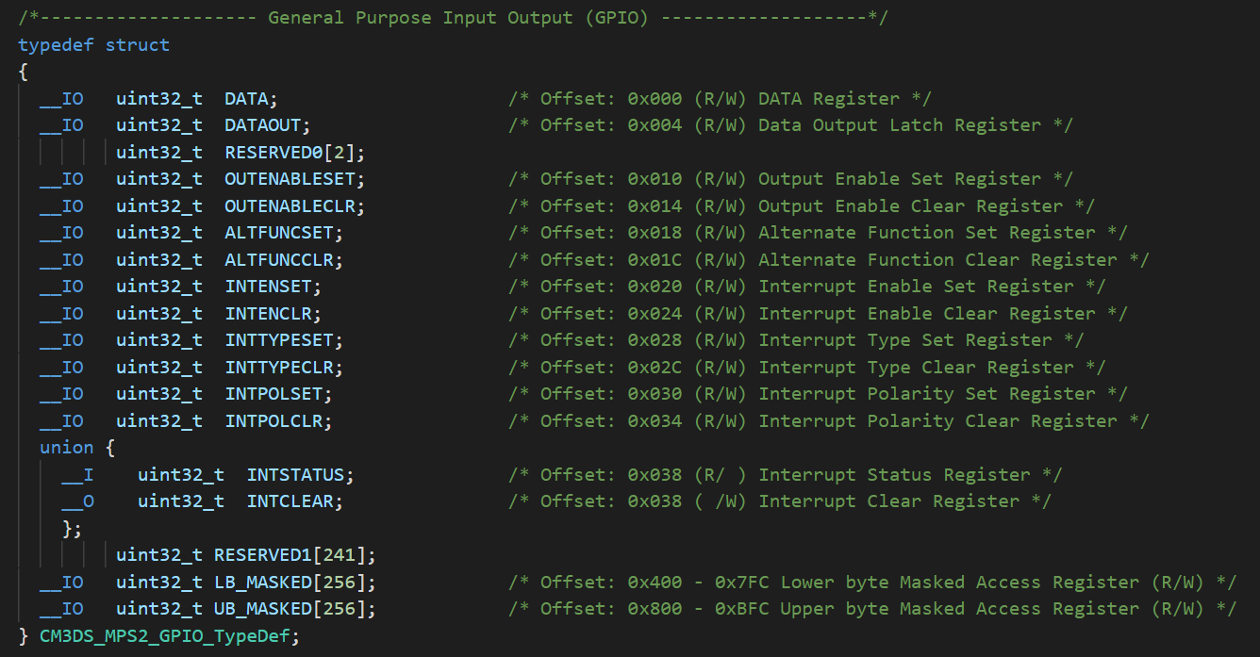
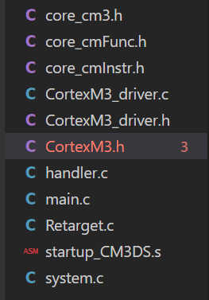
CMSIS (Cortex Microcontroller Software Interface Standard)

Slide 7
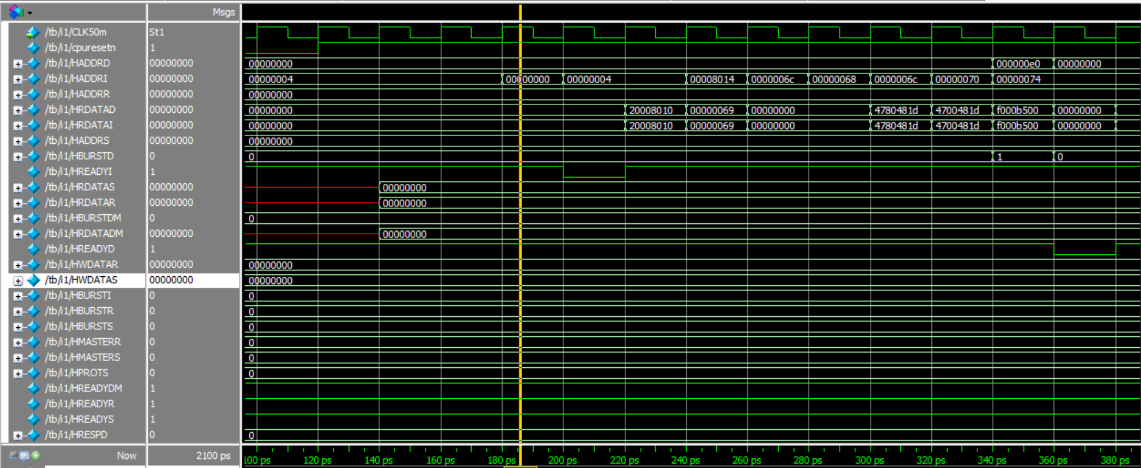
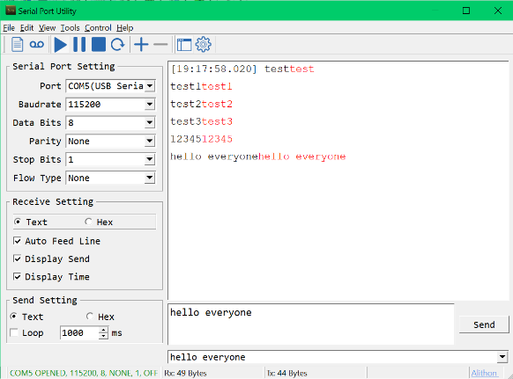
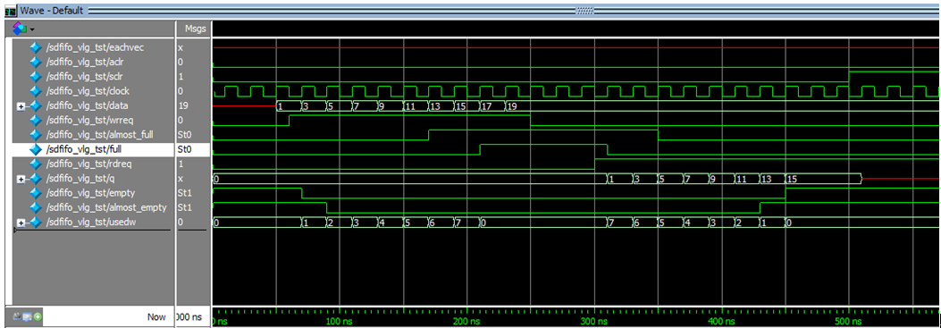
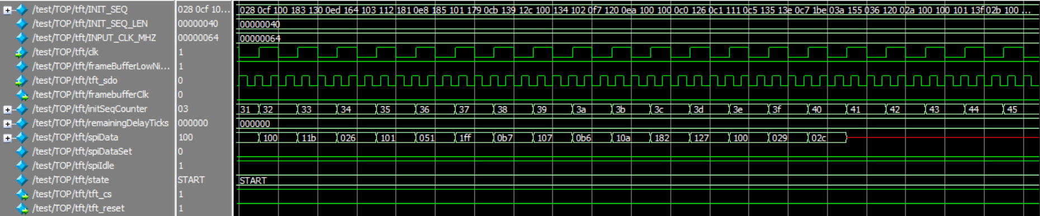
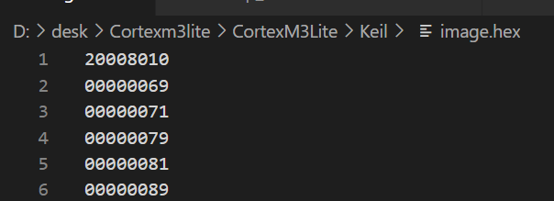
Simulation
UART
FIFO
LCD
Cortex M3 Core

Slide 8
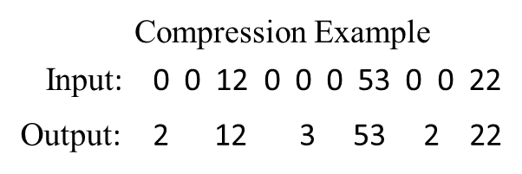
Accelerator
Filt
Spatial Array
Img
Off
chip
memory
Buffer
SRAM
Psum
Psum
加速器总体架构
数据复用机制
数据压缩例子

Slide 9
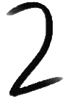



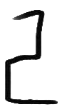
Result & Test
 | 字体宽度/像素 | 能否识别 | 效果
 | 35 | √ | 识别结果略不稳定，易错误识别为7
 | 35 | × | 识别结果不稳定
 | 35 | √ | 识别结果略不稳定，可以正确识别
 | 35 | √ | 效果比较好，可以准确识别
 | 35 | √ | 效果比较好，可以准确识别

Slide 10
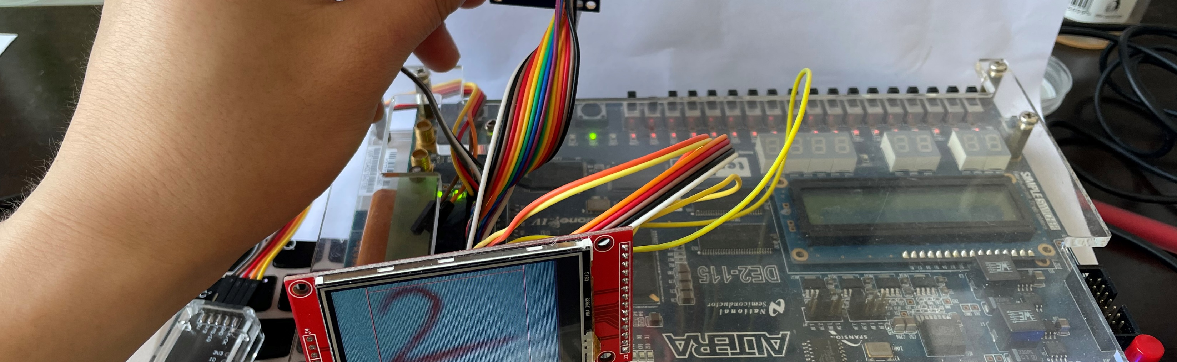
Thanks
17电子02郭世平

